Slide 1
FDP assignment on GEN-AI AI DETECTION FOR EARLY HEART DISEASES presented By M KRANTHI KUMAR(101053) DEPARTMENT OF CIVIL ENGINEERING PACE ITS

Slide 2
Problem Statement:
AI for Early Detection of Heart Disease
* Using Python Programming Language source code was executed and results are shown in the next slides.

Slide 3
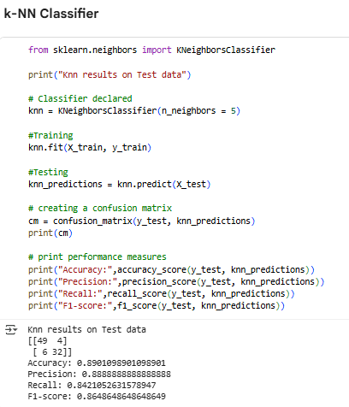
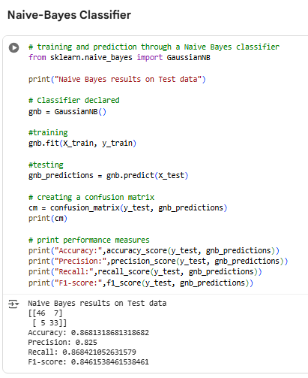
Source Code:

Slide 4
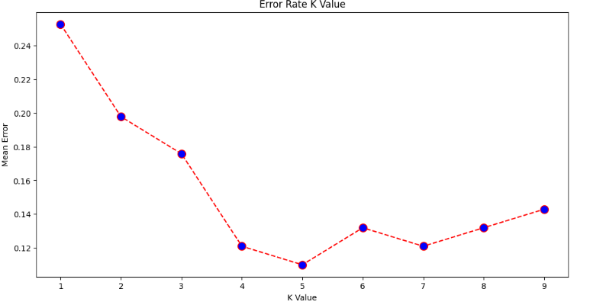
Results:
Execution Graphical Result:

Slide 5
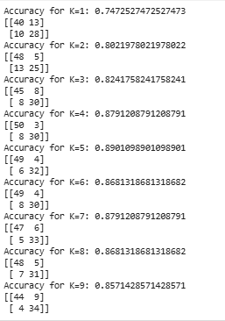
Results(Cont..)
Code Execution Output:

Slide 6


